Slide 1

Mancala
Group member :
Kong Loke Yi SWE1809653
Sii Yew Hei SWE1809657
Tan Li Ying SWE1809658

Slide 2


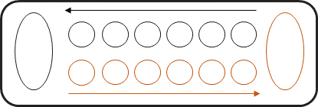

What is Mancala?
Mancala is as known as one of the older most board game which used to be played widely todays.
player2
player1

Slide 3
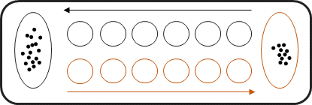
Goal of game:
player2
player1
player2 wins plyer1

Slide 4
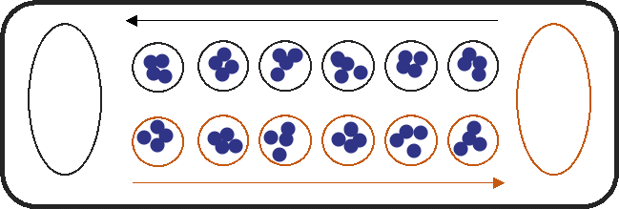
Setting up:
Pits, cups, holes or hollows (in the whole proposal, we will call it as holes)
seeds or stones (we will be called them as stones)
store, home, Mancala, or capture pit (and we will call it as houses in this paper)

Slide 5
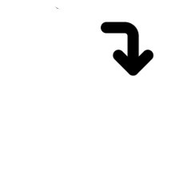
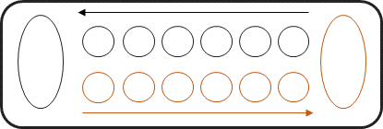
Rules of the playing:
1)
player2
player1
2)
House of player2
House of player1

Slide 6




Rules of the playing:
3)
player2
player1
4)
Only use one hand to pick up as well as put down the stones.

Slide 7

Rules of the playing:
5)
Once the player touches the stones in a hole, he or she must move those stones.
4
4
4
4
4
4
4
4
4
4
4
4
Only put the stones in the home belongs to the player who is now moving the stones, not the home of the opponent.
6)
player1
4
4
4
4
4
5
1
4
4
4
0
5
5

Slide 8
Special Rules:
X 1
The player can take another turn when the last stone in the player’s hand land in the player’s own house.
1)
4
4
4
4
4
5
1
4
4
4
0
5
5
player1
2)
Player1’s
turn
player2

Slide 9

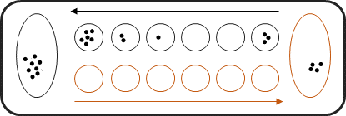
End of the playing:
player2

Slide 10



AI Implementation:
Minimax
Advanced Heuristic Minimax
Alpha-Beta Pruning Minimax
Alpha-Beta Pruning Minimax
Monte Carlo Tree search

Slide 11
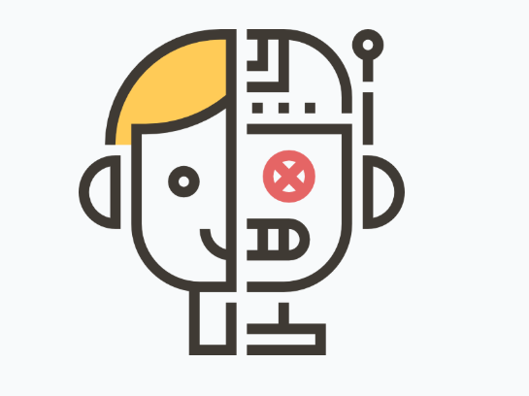

Method towards Mancala

Slide 12
First player to win strategy
First move: Choose the 3rd hole
The last stone land at own house, so can play one more turn

Slide 13
Second move: choose the hole closest to the house
The last stone drops at opponent 3rd hole, so the opponent cannot get the one more turn in his first move

Slide 14
Alpha- beta pruning
Current board
For each node, branch out 6 child nodes
Player 2 (AI) moves
(depth =1)
For each node, branch out 6 child nodes
Player 1 (Human) moves
(or Player 2 moves again)
(depth = 2)
Value of Alpha and Beta = evaluation score at each hole
Pruning happen when Alpha >= Beta
Until depth 9

Slide 15
Alpha- beta pruning
Alpha Beta Move algorithm
Function alphaBetaMove(board, depth (ply))
Let the alpha = negative infinity
Let the beta = positive infinity
Return maximum value of alpha by calling the function alphaMaxValue
Above retrieve about the function to choose a move with alpha beta pruning.

Slide 16
alphaMaxValue
Alpha max value algorithm
function alphaMaxValue (board, ply, turn, alpha, beta)
#input: board, depth of search, ply, alpha and beta value
#output: score of the player, score and which move to choose, move
if board.gameOver ( ) or ply == 0 or (board.scoreHoles[0] – board. scoreHoles[1]) > 24
return turn.score (board) , -1
score ←-∞
move ←-1
for m in board.legalMoves ( ) do
opponent ←Player (opp, type, ply)
nextBoard ← deepcopy (board)
again= nextBoard.makeMove (m)
end for
if again == True then
s, m ← alphaMaxValue (nextBoard, ply-1, turn, alpha, beta)
else
s, m ← opponent.alphaMinValue (nextBoard, ply-1, turn, alpha, beta)
end if
if s> score then
score ← s
move ←m
if score >= beta then
return score, move
if score > alpha then
alpha= score
return score, move

Slide 17
alphaMinValue
Alpha min value algorithm
Function alphaMinValue (board, depth (ply), turn, alpha, beta)
If board.gameOver() or ply == 0 or abs(board.scoreHoles[0] - board.scoreHoles[1]) > 24:
return the score of the score and move
Let the score = infinity
Let the move = -1
for m to the legalMoves() do
Let opponent = Player (opp, type, ply)
nextBoard = deepcopy(board)
again = nextBoard.makeMove(m)
If again
s, mv = alphaMinValue(nextBoard, ply - 1, turn, alpha, beta)
Else
s, mv = opponent.alphaMaxValue(nextBoard, ply-1, turn, alpha, beta)
end if
if s < score
score = s value
move = the m value
if score <= alpha
return score and move
if score < beta
beta = the score value
end for
return score and move

Slide 18
chooseMove
Choose move algorithm
Function chooseMove(board)
//Input: Mancala board
//Output: returns the next move that the AI player makes
if (type == ABPRUNE)
val, move ← alphaBetaMove(board, ply)
print the chosen move and the value
return move
Returns the next move that the AI player makes.
Function alphaBetaMove() is called to get the move and evaluation value that obtained by performing alpha-beta pruning and heuristic evaluation.

Slide 19
Legal Move
The legalMove() function returns whether a move is legal or not.
The function gets the row of holes for the current player and check the legal move.
A legal move should follow that the hole is in the range of the number of holes for one row.
The current hole should also not to be empty to allow move to the next hole.
Legal move algorithm
Function: legalMove (player,hole)
//Input: the player’s turn (Player 1 or Player 2) and the next hole to be moved
//Output: return true or false for a move
if (player.num==1)
holes←P1Holes
else
holes←P2Holes
End if
return hole > 0 && hole <= len(holes) && holes[hole-1] > 0

Slide 20
Legal Moves
Legal Moves algorithm
Function: legalMoves (player)
//Input: the player’s turn (Player 1 or Player 2)
//Output: a list of legal moves
if (player.num==1)
holes←P1Holes
else
holes←P2Holes
end if
moves= [ ]
for m in range of length of holes
if (holes[m]!=0)
moves←moves + [m+1]
end for
return moves
Gets the row of holes for the current player and initializes a list for moves.
For each hole which in the row, the index of the hole is stored into moves and the function eventually returns a list of legal moves, moves[ ] .

Slide 21
Score algorithm
function: score(board)
//Input: Mancala board
//Output: evaluation of the Mancala Board for AI player
if (board.hasWon(num))
return 500.0
else if (board.hasWon(opp))
return -500.0
else if (board.scoreHoles[num - 1] > 24)
return 250
else if (board.scoreHoles[opp - 1] > 24)
return -250
Heuristics
H1: Has AI won the game.
H2: Has opponent won the game.
H3: How close AI are winning.
H4: How close opponent are winning.

Slide 22
Initialization
else
if (self.num == 1):
holes ← board.P1Holes
oppHoles ← board.P2Holess
scoreDiff ← board.scoreHoles[0] - board.scoreHoles[1]
else
holes ← board.P2Holes
oppHoles ← board.P1Holes
scoreDiff ← board.scoreHoles[1] - board.scoreHoles[0]
score ← (scoreDiff + 30) * 10 / 6
additional ← 0.0
capturing ← 0.0
stones ← 0.0
Initialize player’s row of holes and opponent’ s row of holes
Get the score difference between two houses
Initialize score, additional, capturing and stones

Slide 23
Evaluate the score for the move at each hole
Evaluate the value of additional
for i in range of length of holes do
numStones ← holes[i]
if (numStones > 0 || oppHoles[i] > 0)
if (numStones == (6 - i))
additional← (50.0 * (i + 1))/6
Get the number of stones at the current hole
If there are stones in the player’s or opponent’s hole
if the number of stones is sufficient to drop the last stone into the house → get additional turn
Evaluate the additional value
Heuristics
H5: Choose a move that can lead AI has one more turn in the game.

Slide 24
Evaluate the score for the move at each hole
Evaluate the value of capturing (stones captured by opponent)
temp ← oppHoles[i] % 13
temp_capturing ← 0.0
ownStones ← -1
if (temp <= (5 - i))
if (temp == 0)
ownStones ← holes[5 - i]
else
ownStones ← holes[5 - i - temp]
else if (temp >= (13 - i))
ownStones ← holes[5 - i + temp - 13]
Initialize temp, temp_capturing, ownStones
Know which hole the opponent will land from the value of temp
If the last stone of opponent lands on an empty hole, it can take away all the stones from the opposite holes which belong to AI.

Slide 25
Evaluate the score for the move at each hole
Evaluate the value of capturing (stones captured by opponent)
Evaluate the number of stones owned by opponent
50 scores if the opponent takes no stones
40 scores for 1 stone
25 scores for 2 stones
The higher the scores, when the opponent take less stones from AI player.
Update the value of capturing to get the highest evaluation
if (ownStones == 0)
temp_capturing ← 50.0
else if (ownStones == 1)
temp_capturing ← 40.0
else if (ownStones == 2)
temp_capturing ← 25
if (temp_capturing > capturing)
capturing ← temp_capturing
Heuristics
H6: How many stones can opponent take from AI rows of holes.

Slide 26
Evaluate the score for the move at each hole
Evaluate the value of stones
Heuristics
if (numStones < 4)
stones ← stones + 5
else
if (i == 5)
stones ← stones + 30
else
stones ← stones + 10
H7: Number of stones of the chosen move are less.
H8: Keep the last stones get into its own house.
H9: Stones land at other holes.
total = capturing + score + additional + stones
return total
Total evaluation score

Slide 27
Error Analysis and Experiment
Flaws
the first step of the AI player takes long time
compute the Alpha-Beta pruning with the depth of 9
AI player will take a second turn
Experiment

Slide 28

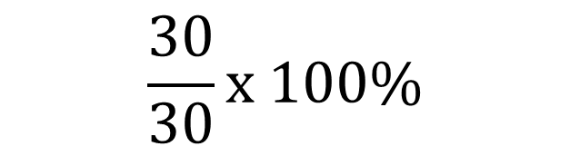
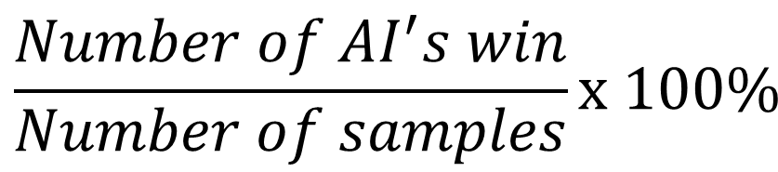
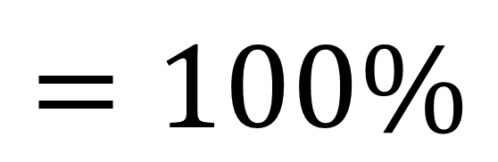
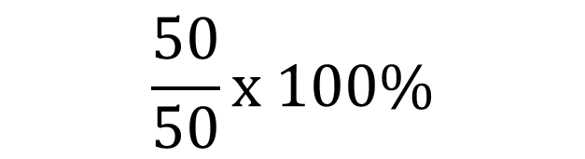
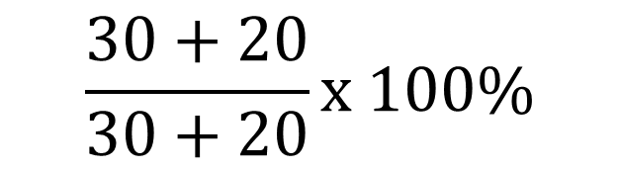
Experiment
Advance Player (Group members)
Beginner Player (Ms. Tay & Ms. Chien)
No. | AI score | Human score | Winner
1 | 41 | 7 | AI
2 | 25 | 23 | AI
3 | 31 | 17 | AI
4 | 38 | 10 | AI
5 | 25 | 23 | AI
6 | 27 | 21 | AI
7 | 41 | 7 | AI
8 | 36 | 12 | AI
9 | 29 | 19 | AI
10 | 41 | 7 | AI
11 | 35 | 13 | AI
12 | 41 | 7 | AI
13 | 41 | 7 | AI
14 | 27 | 21 | AI
15 | 28 | 20 | AI
16 | 28 | 20 | AI
17 | 41 | 7 | AI
18 | 42 | 6 | AI
19 | 29 | 19 | AI
20 | 41 | 7 | AI
21 | 38 | 10 | AI
22 | 37 | 11 | AI
23 | 42 | 6 | AI
24 | 35 | 13 | AI
25 | 25 | 23 | AI
26 | 36 | 12 | AI
27 | 27 | 21 | AI
28 | 32 | 16 | AI
29 | 26 | 22 | AI
30 | 41 | 7 | AI
No. | AI score | Human score | Winner
1 | 41 | 7 | AI
2 | 38 | 10 | AI
3 | 29 | 19 | AI
4 | 40 | 8 | AI
5 | 34 | 14 | AI
6 | 35 | 13 | AI
7 | 36 | 12 | AI
8 | 35 | 13 | AI
9 | 41 | 7 | AI
10 | 30 | 18 | AI
11 | 40 | 8 | AI
12 | 31 | 17 | AI
13 | 41 | 7 | AI
14 | 42 | 6 | AI
15 | 33 | 15 | AI
16 | 36 | 12 | AI
17 | 41 | 7 | AI
18 | 40 | 8 | AI
19 | 31 | 17 | AI
20 | 31 | 17 | AI
$$=100\%$$
$$\frac{50}{50}x 100\%$$
$$\frac{Number of AI^{′}s win}{Number of samples}x 100\%$$
$$\frac{30+20}{30+20}x 100\%$$
$$\frac{30}{30}x 100\%$$
Accuracy =

Slide 29
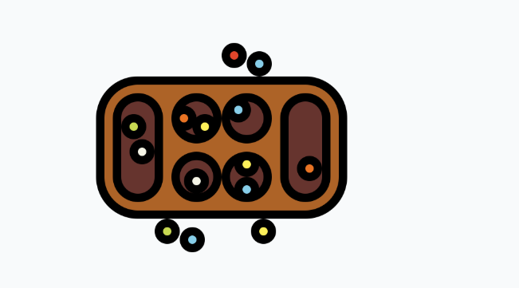
Conclusion
Mancala Board Game
Alpha-Beta Pruning Minimax algorithm
Heuristics - decide the movement for the AI player
AI player won with accuracy of ­100%

